Slide 1
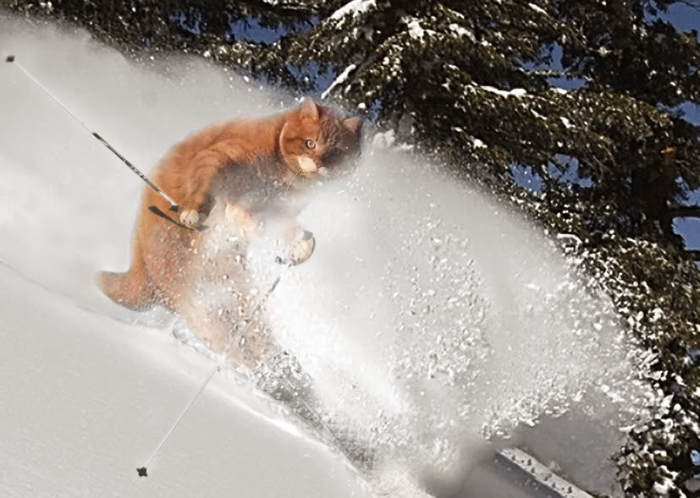
PPD H2020 1 Feb 2016
Intro
News – Katie
Procedures for Bids – Stephen
Status
Surgery – all
https://twiki.pp.rl.ac.uk/twiki/bin/view/Main/PpdBids

Slide 2
Procedures for Bids
If you would like to make a bid (H2020 or for any external grant):
Contact Div Heads (Dave W, Stephen H, Claire S) at an early stage in your considerations - they will need to identify whether a) your ideas fit with the PPD strategy and b) will not create significant financial liabilities.
You will need to create an entry in the Bid Register - Chris Lowe can advise. See Instructions and Flow Chart.
You will need to set up a Bid Review - allow a couple of weeks for this. This will need to engage
a Chair (Chris Lowe or Stephen H)
PPD Mgmt (Stephen H or Claire S)
Finance (Steph Rankin) and
a representative from Legal and Commercial - for H2020, Branwen Hide will play this role, reporting back to L&C for sign-off.
Bid Reviews will need a Finance template (issued by Finance)
Bid Reviews will use a standard Agenda.
Once the bid is approved, quotes can only be issued by Legal and Commercial.
Katie Lambert can advise of H2020 strategy and help people identify calls. If you need help on completing bid forms, ask Branwen Hide.
Be wary of taking leadership of projects - this can involve a great deal of work.

Slide 3
Bid Review
Introduction
Business Fit
Finances
Management Proposal - issues, including L&C
Bid Schedule
Risks
Legal and Commercial
Action Items
AOB
Conclusion

Slide 4
Bid Review
Introduction
Should include customer name; outline of proposal, collaboration/consortium etc
Business Fit
Fit with PPD Programme, i.e. participates in and supports the UK particle physics experimental programme, synergies with other Programmes, experience and skills, existing facilities etc
Finances
All costs included – staff, materials, facilities, travel, shipping, sub-contractors, burden rate etc.
Overheads.
Quotes received for sub-contractors or capital/recurrent expenditure
Exchange rate risks and exchange rate used
VAT Status
Contingency & Margin adequate
Penalties
Justification of price less than FEC
Matching funding
Revenue management
Management Proposal - issues, including L&C
IPR issues/confidentiality issues. IPR arising, ownership, exploitation
Personnel – availability, recruitment issues
Cover letter contents. In the ITT what is required by way of cover letter content, e.g. programme of work, ‘company’ background, customer template, named personnel etc
Contract terms
Penalties
Export licences
Bid Schedule
Bid to be submitted
Duration of work –start and end
Risks
Deliverable, timescales etc and any mitigating factors that can be put in place to reduce identified risks, such as milestones, acceptance criteria
Legal and Commercial
Action Items
AOB
Conclusion

Slide 5
Status – PPD Bids
1 | Wark | RISE: Jennifer/T2K-HK | Retrospectively | Awarded Sep 2014 | In conjunction with di Lodovico; STFC to handle travel money.
2 | Worm | RIA (Aida 2020): Det Instrumentation | Y | Awarded 2014
3 | Worm | RISE: Exchange for DM |  | Abandonned | To fund visitors
4 | Worm | ERC: Research Grant |  | Bid due 6/15
5 | Worm, Wilson, McMahon | ITN: Training for CMOS |  | Abandonned | For 1-2 students for 3 years
6 | Dewhurst | Tier 1 Collaboration |  | Contemplating
7 | Shepherd-T | ITN FP7: Infieri |  | Awarded
8 | Matheson | Medical |  | Awaiting suitable call | Katie to advise John
9 | Paling | Integrating activity - DULIA |  | Rejected; resubmit in Mar 2016 | Integate across EU Undgnd Labs
10 | Zhang, Villani | Dosimetry sensors |  | Contemplating | Also consider EPSRC funding
11 | Dopke | CT scanning ancient scrolls |  | Contemplating
12 | Kelsey, Cornwall | EINFRA - Authentication & Authorisation |  | Submitted
13 | Kelsey, Cornwall | EINFRA - Open Source Commons |  | Submitted
14 | Kelsey, Cornwall | EINFRA - Globus |  | Submitted
15 | Kelsey, Cornwall | EINFRA - Very large data |  | Submitted
16 | Ricciardi | ITN: Mice | Y | Rejected | To fund a student
17 | Edgecock | ECR: Advanced researcher |  | Contemplating
18 | Wilson | Marie Curie: Fellowship |  | Bid due in 8/15
19 | Wilson | FET: Si Technology |  | Considering
20 | Wilson | RISE: Randalf |  | Rejected; resubmit | Lepton Facility

Slide 6
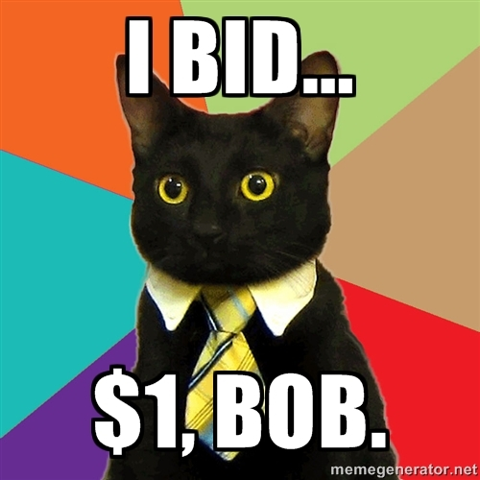
Status – Other Bids
1 | Andreopoulos | ERC: Research Grant |  | Resubmit | Liverpool
2 | Andreopoulos | ITN: |  | Contemplating | Liverpool
3 | Andreopoulos | MSCA-RISE: Fermi-LAr |  | Bid due 30/5/15 | Liverpool
4 | Edgecock | Healthcare |  | Rejected | Huddersfield
5 | Edgecock | EUCard2 |  |  | Huddersfield, with Astec + TNA (Mice)
6 | Paling | ITN: Students. Multi-Deep |  | Rejected; resubmit | Sheffield. For 15 PhD students.

Slide 7
Surgery
https://twiki.pp.rl.ac.uk/twiki/bin/view/Main/PpdBids
Useful Links
PPD Bids Status.
Old page - created by Fergus. While some of this is out of date, there is some very useful information.
Training - Branwen Hide - 18 Jan 2016
Slides (pdf)
Docs
H2020 Costing Guide (pdf)
Claiming expenses (pdf)
Types of personal (pdf)
Third parties (pdf)

