Slide 1
PPD H2020 Survey
Stephen Intro 5’
Katie Her role 15’
Chris Additional support
Katie (for Alex) UKRO role 10’
Steph Finance perspective 10’
All PPD interests 30’
All Q&A 20’

Slide 2
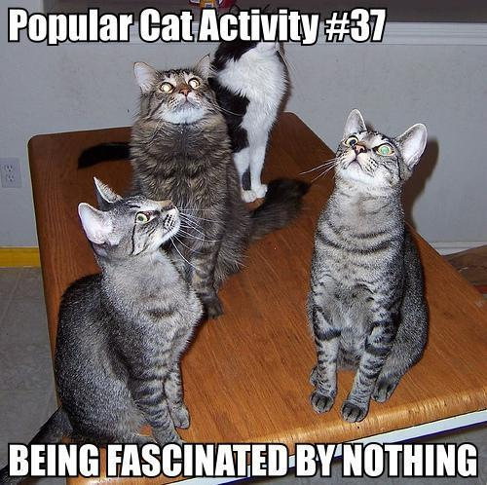
PPD H2020 Activity
Who | What | Status
Wark (Lowe) | T2K/T2HK | Awarded
Worm | RIA – Det instrumentation
 | RISE – Exchange for DM
 | ERC – Research grant
+Wilson + McMahon | ITN – Training for CMOS
Andreopoulos | ERC – Research Grant
Dewhurst | Possible Tier-1 | Interested
Paling | ITN – Student training
 | Integrating activity
Shepherd-T
Kelsey/Cornwall
Edgecock
Ricciardi
Matheson
Dopke, Cockerill | Interested

Slide 3
Dave Wark
Jennifer – T2K/T2HK
The Project commences 1 April 2015 and lasts for 4-years
QMUL were bidding originally but would have problems paying non-QMUL people so invited STFC via PPD (Dave Wark) to join as we have a track record of paying non-staff in Universities
The bid was pulled together by QMUL and financial details ‘refined/honed’ in discussion between INFN and the EC. I am chasing QMUL to establish exactly what the €171k funds
QMUL are progressing the ‘associated with’ question Gillian
The award is all travel funding (tbc) for the T2K and T2HK experiments
The split between payments to HEI and STFC staff is not absolute/defined. Dave would estimate €75k STFC and €96k HEI’s if pushed
Presently travel (to T2K and T2HK experiments) is met from a PD allocation (STAK00018 and STAK00060). Dave Wark has advised Tony Medland he has secured EC funding that should either reduce the call on the allocation or increase the number of STFC and HEI travellers – TBD

Slide 4
Steve Worm
RIA: Infrastructure bid (AIDA-2020)
- HEP detector instrumentation
- Follow-on from EUDET/AIDA bids
- submitted in July
- funding for 1-1.5 FTE
ITN: training network
- training for design & testing of CMOS pixel sensors
- with Steve, Fergus, bunch of partners
- due in January (or maybe August)
- funding for 1-2 students x3 years each
RISE: staff exchange
- dark matter and other new phys
- several European countries, also Thailand, Egypt (possibly CERN)
- due in April
- funding for long-term visits/visitors
ERC: advanced grant
- worth a shot at some point
- two or three month effort
- due June 2
- funding for research programme, up to 2.5 mil euro

Slide 5
Costas Andreopoulos
ERC Consolidator Grant application for €2M
Passed stage 1; interview in Brussels ~25 Nov
(~50% chance now of this getting approved).
with Liverpool but, if approved,
plan to have a people stationed at RAL for large-ish fraction of their times.
at later time, submit an MSCA ITN proposal & have already made the contacts to establish a network of theorists and experimentalists and define its objectives

Slide 6
Rob Edgecock
I'll be running a workshop that is part of the EuCARD2 FP7 project on Thursday, so can't come to the meeting.
I am a work package coordinator in an H2020 Healthcare programme "PHC-16 Tools and technologies for advanced therapies" first stage proposal that was submitted at the start of last month. This is coordinated by the University of Pavia. However, as I mentioned, this is for the University of Huddersfield as, all other things being equal, the administration is easier.

